Slide 1




Making good scientific figures
Kendrick Kay
kay@umn.edu • http://cvnlab.net
Center for Magnetic Resonance Research (CMRR)
University of Minnesota, Twin Cities
These slides:
More information:

Slide 2
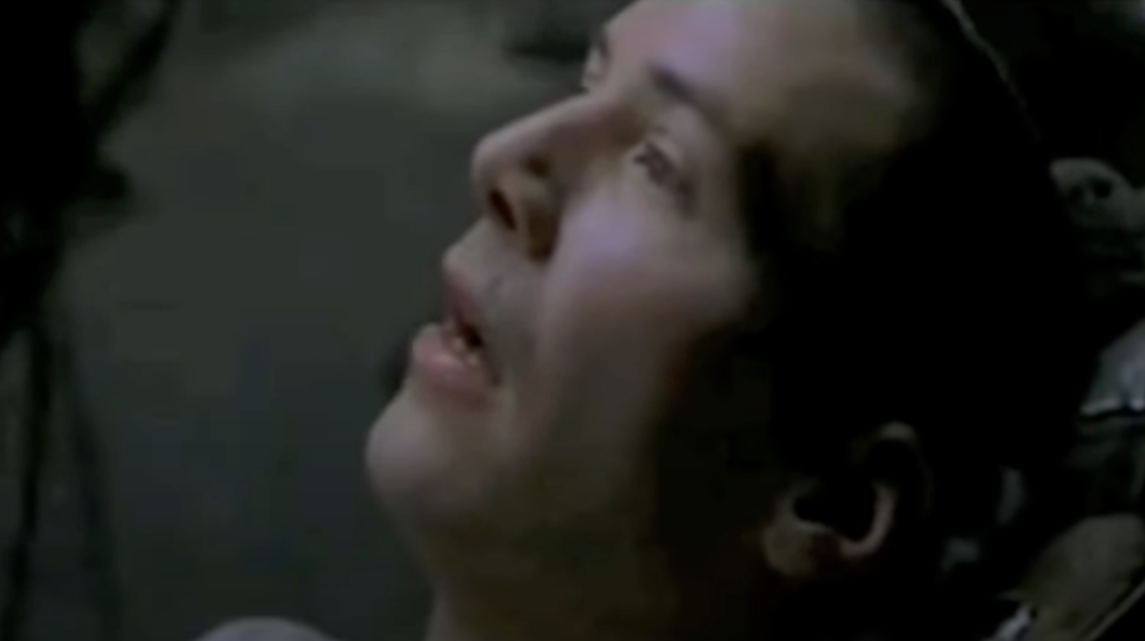
What is the goal of a scientific figure?
The goal is to communicate information (about data):
Data points, how you analyzed them, and the “final answer”
The more information conveyed, the better (up to a point)
You want to transmit information to the reader so well that they “get it”

Slide 3
What makes a good figure?
Technically precise and accurate
Visually appealing and inviting
Reader gets information quickly and with low effort

Slide 4
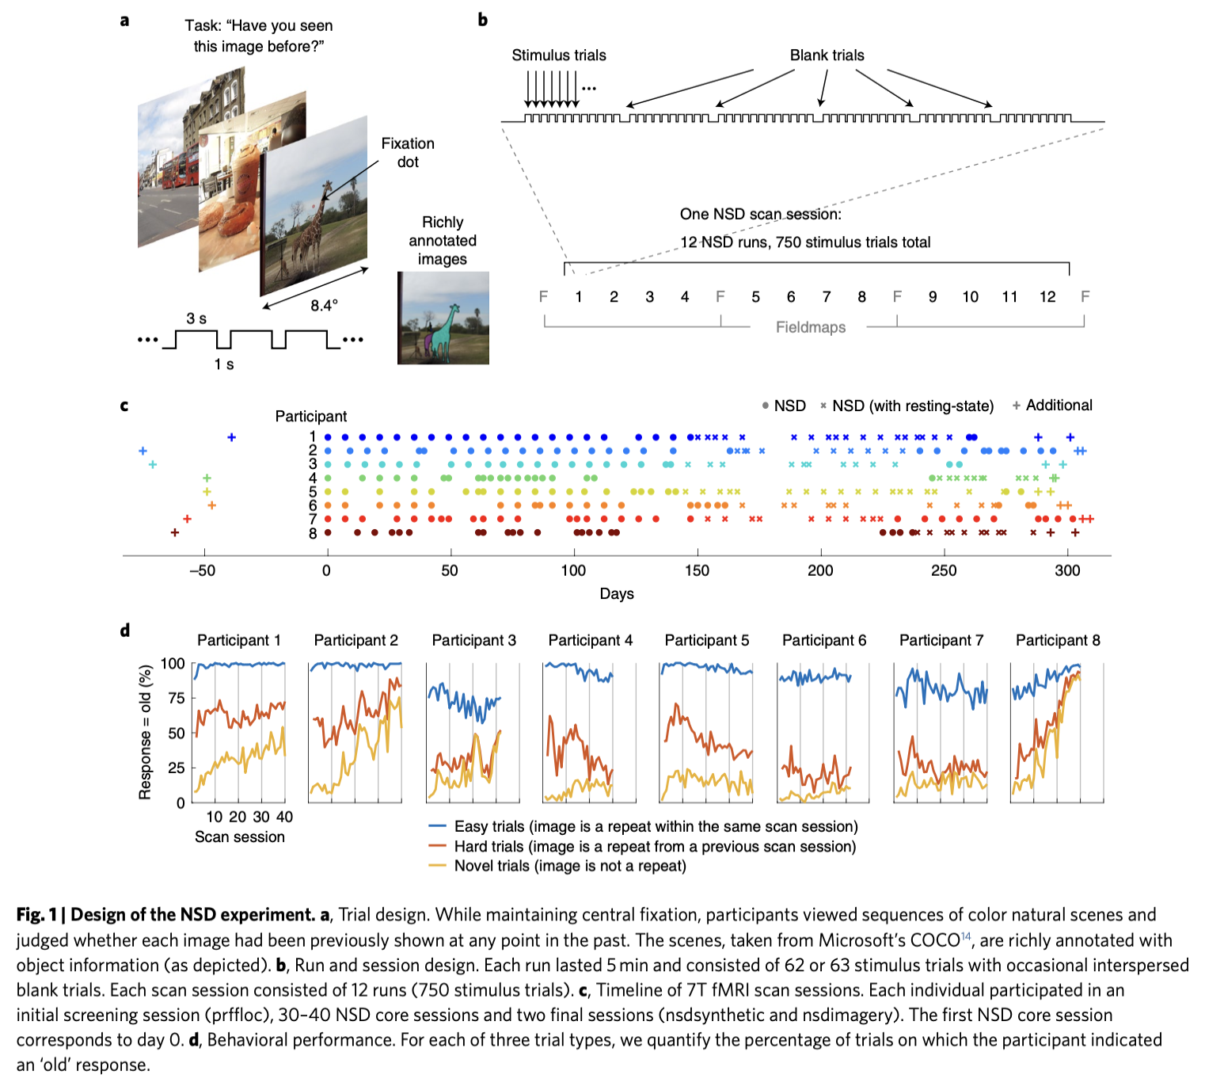
Designing a good figure
Every little thing counts (e.g., choice of visual elements, color, line width, spacing and alignment, text labels, colormap choice, axis ranges, text size)
Aesthetics are important: make the content easy-to-swallow
Division of labor between what’s on the figure and what’s in the caption. Use this to your advantage.
White-space efficiency. Use space wisely.
Think hard about the point of the figure. Optimize for that.

Slide 5
Tips
Iterate. Figures have a lot of interacting parts, so it may take time to settle on an optimum.
Automate as much as possible (via code); manually tweak only at the end
Get honest feedback (show a naive observer your figure and see if they can explain it back to you)

Slide 6
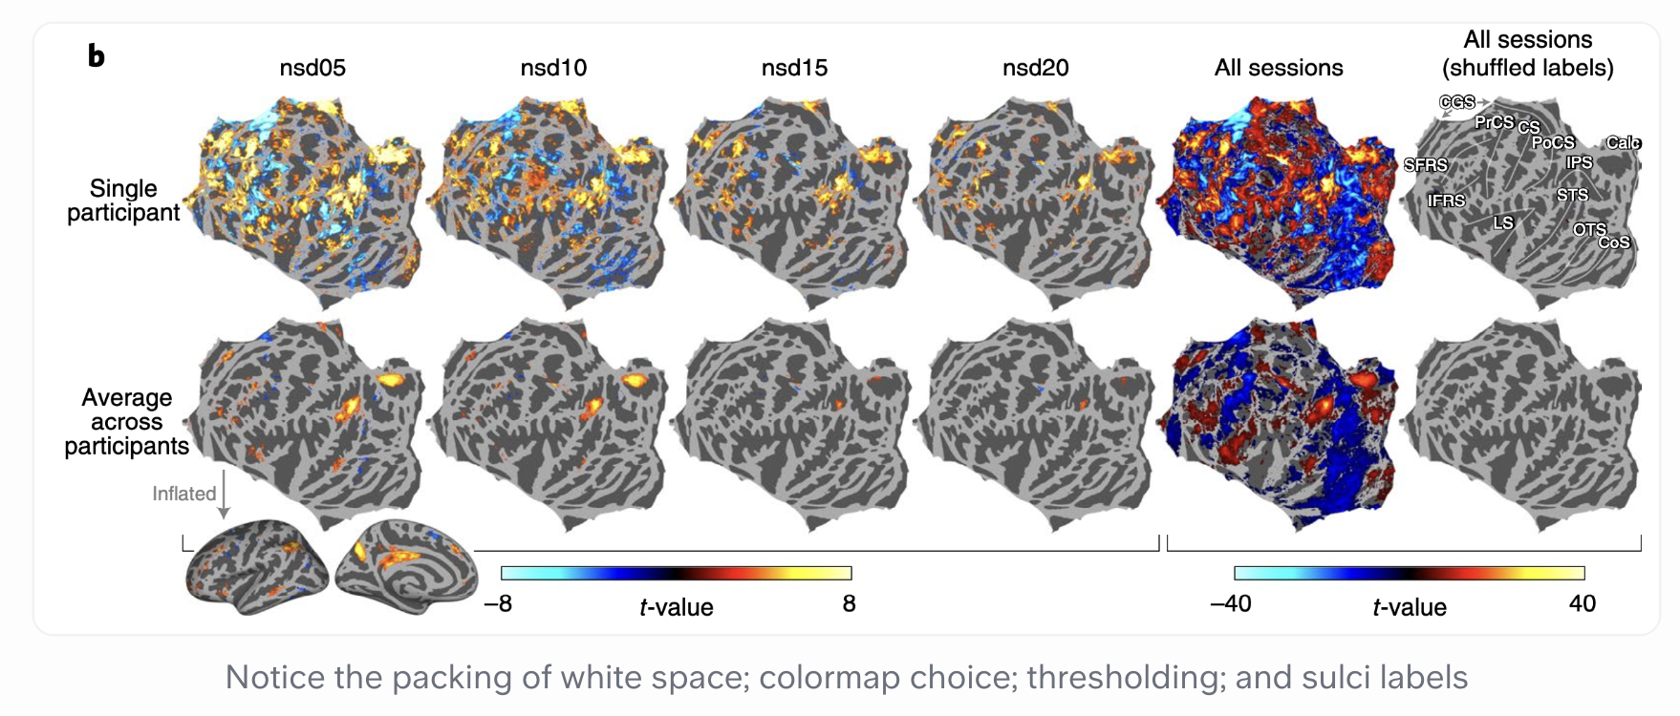
More examples

Slide 7
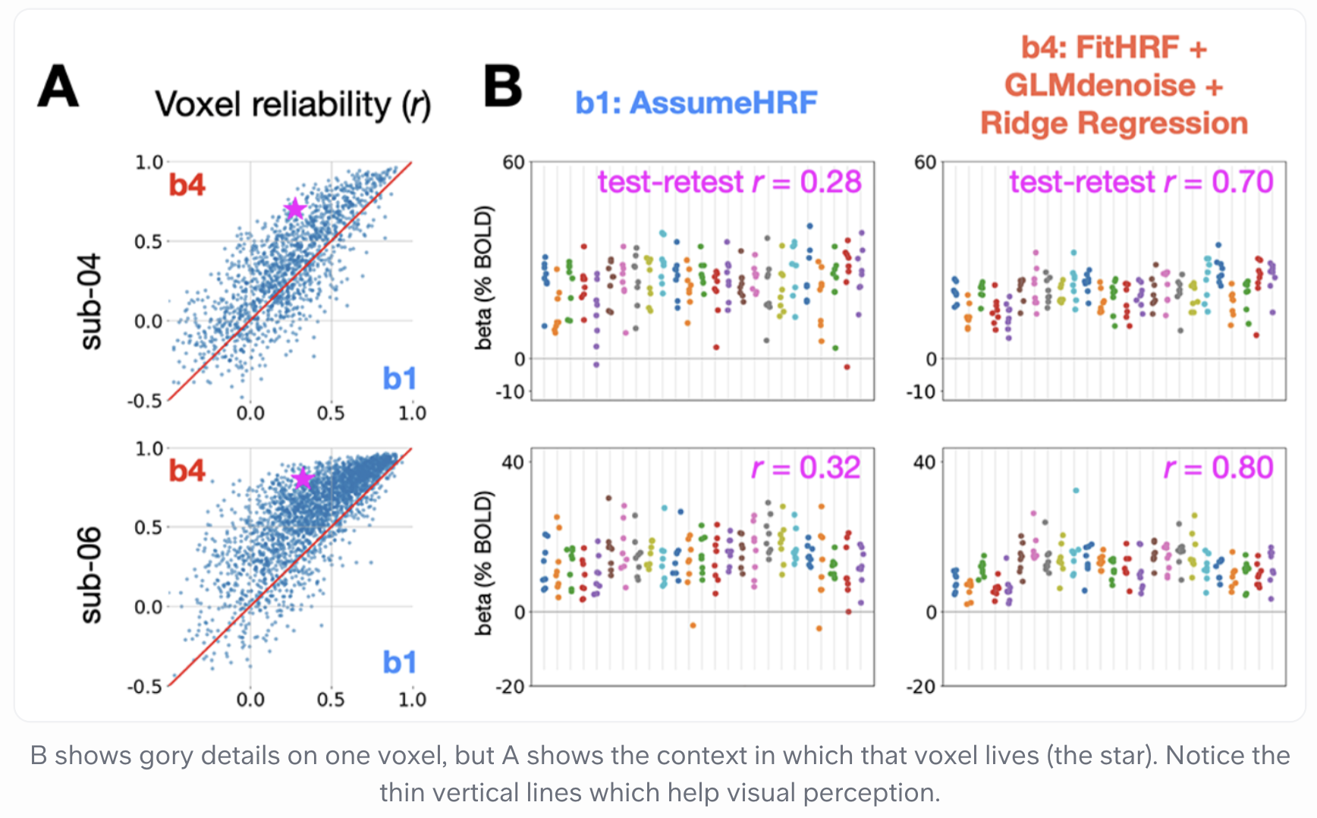
More examples

Slide 8
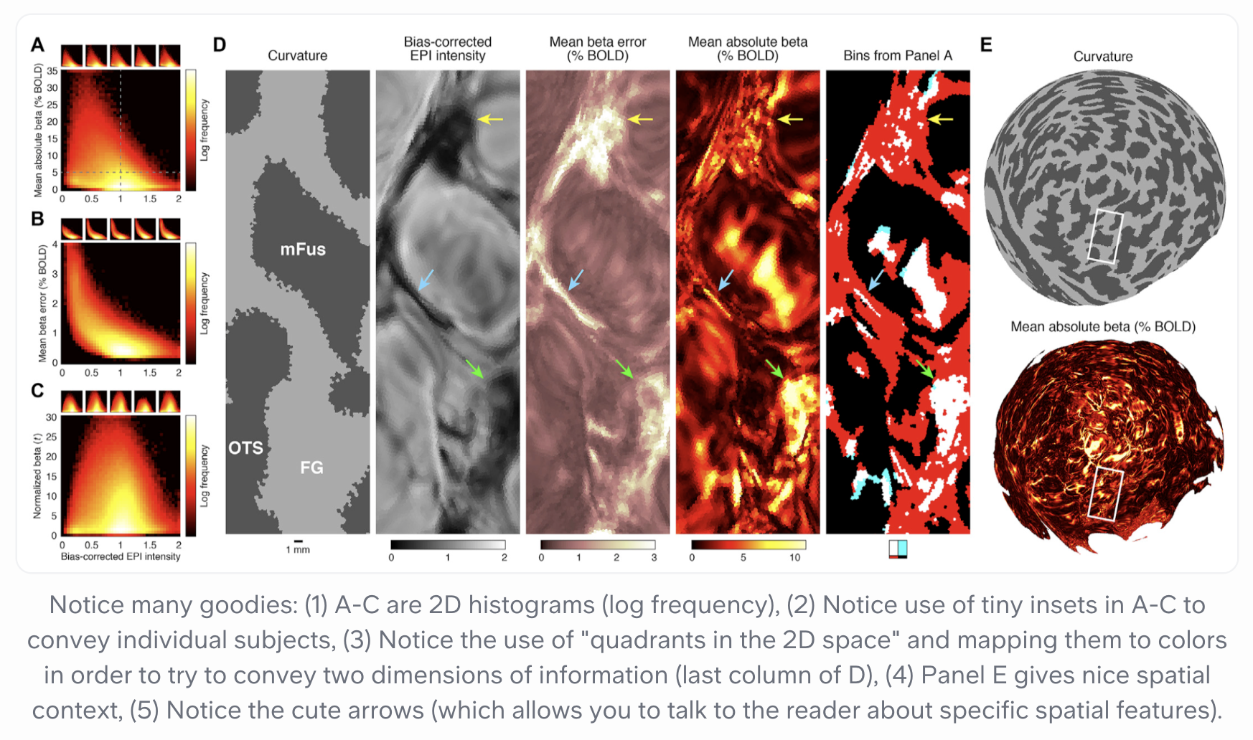
More examples

Slide 9
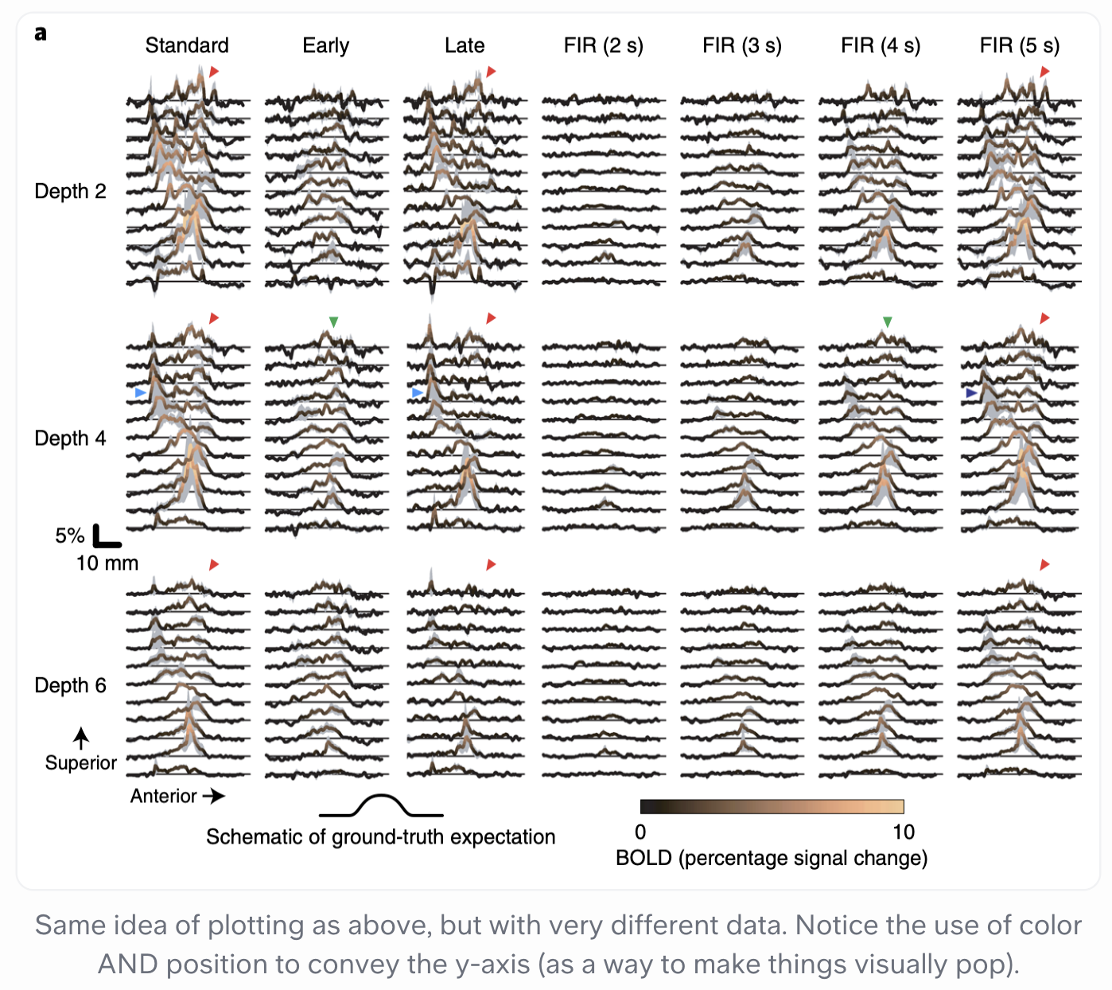
More examples

Slide 10
More examples
See more examples at:

Slide 11
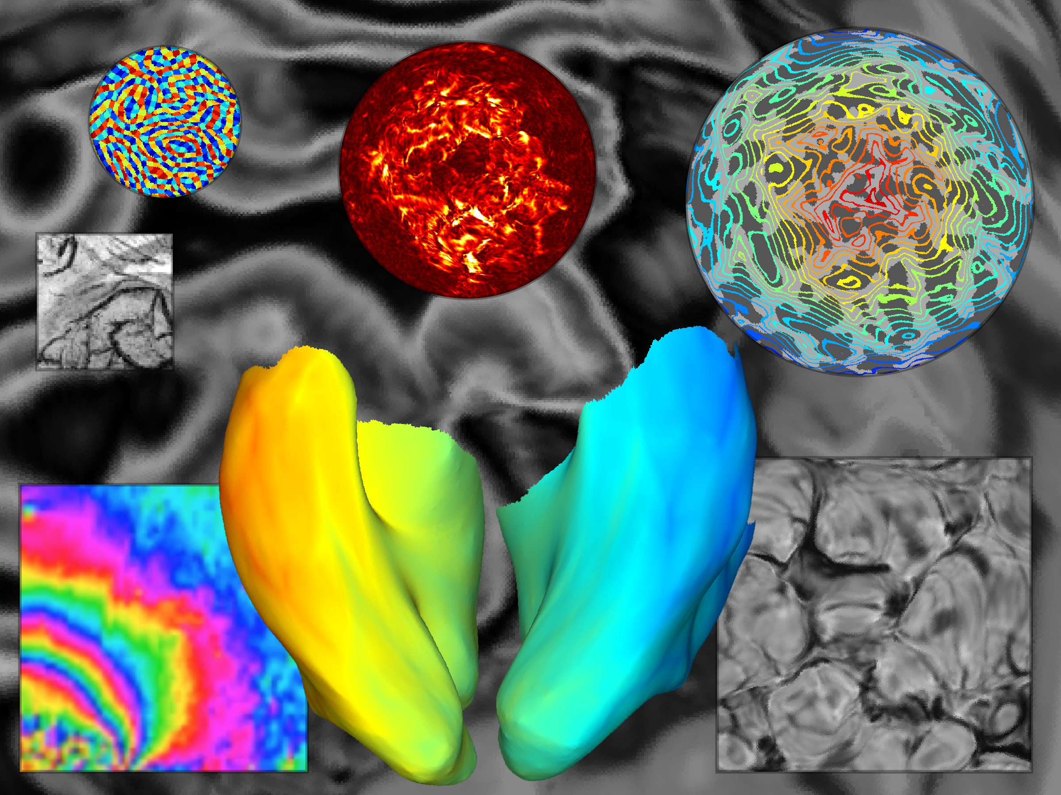
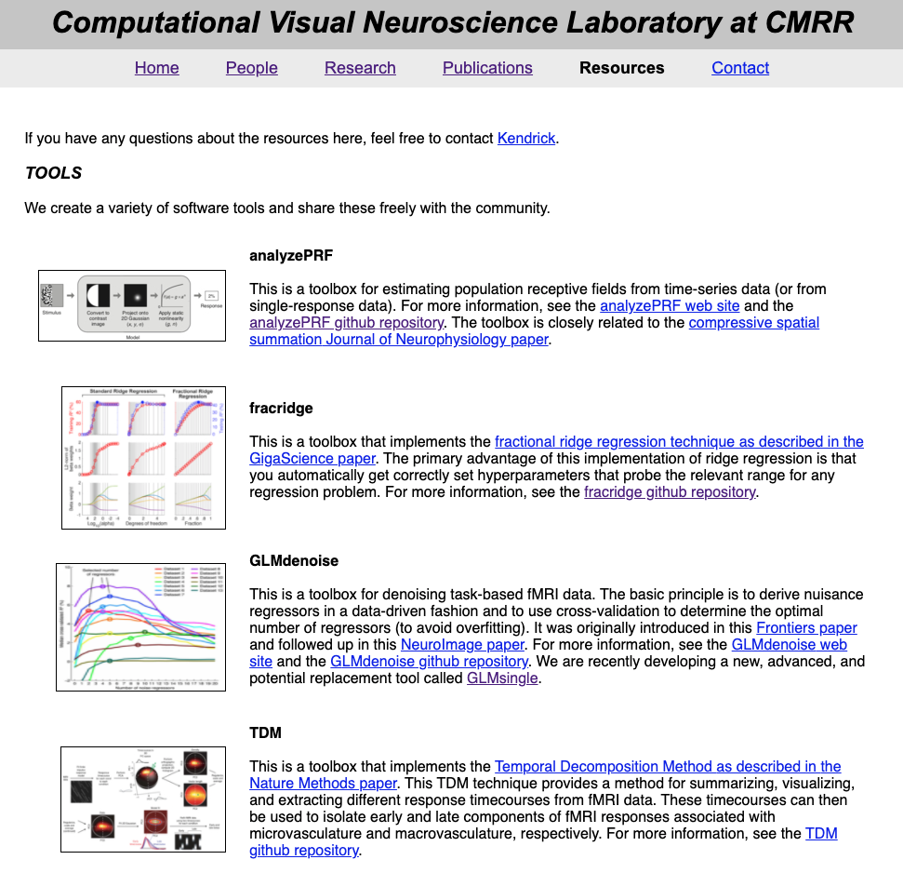
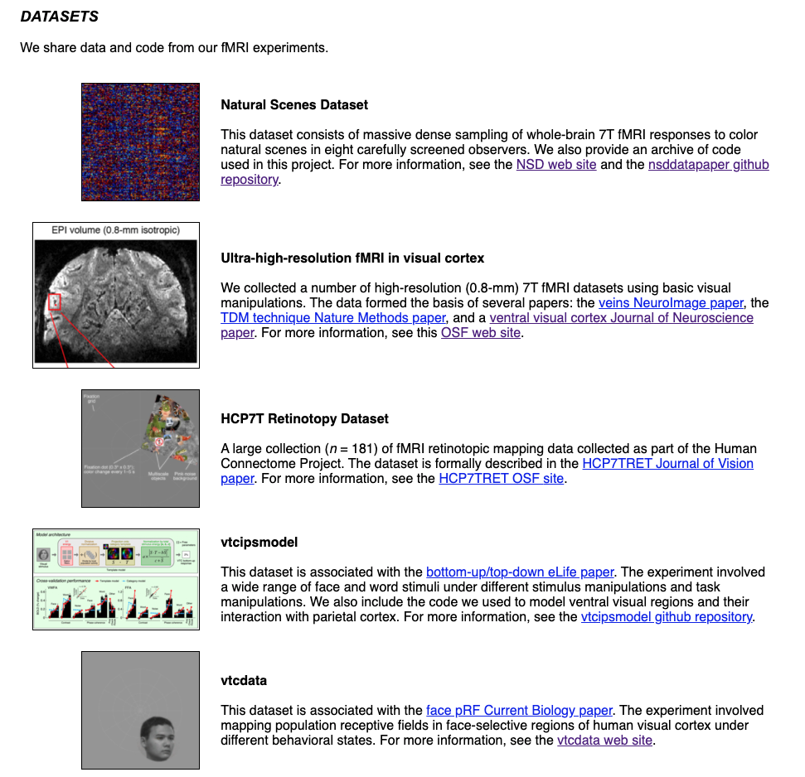
http://cvnlab.net
CODE
DATA

